Slide 1
What should I know about Pathways?
Your Pathways Ambassador: Sabine Schmelzer (BS),
(Your Pathways Guide: Katja Töttler)
Notes:
You will get this presentation + extra slides through VPE

Slide 2
Agenda
Overview Pathways Elements
How to access Pathways
Your assessment before you start
The new evaluation
Levels and Project types
Pathways and easy-Speak
Questions
Notes:
You will get this presentation + extra slides through VPE

Slide 3
Current educational program
https://www.toastmasters.org/resources/the-toastmasters-educational-program
Notes:
ACTIVITY:
- Abbott: do you know the 2 tracks? + current level?
- Normal: note best guess: when last major update?

Slide 4
2 Tracks vs. 10 Paths
10 paths to the top
https://www.youtube.com/watch?v=ewU_BbArY88
Notes:
Path = Lernpfad

Slide 5
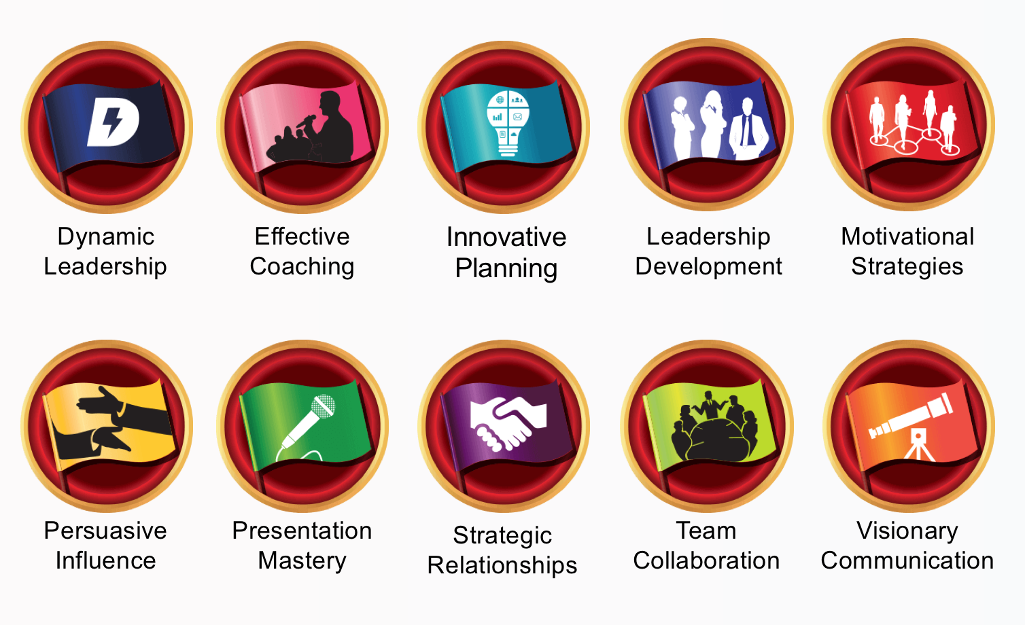
Choose your Path
Notes:
✔️ = only 2 paths available in print AND in other languages than English (Leadership Development + Presentation Mastery)
Paths available in printed material (ENGLISH):
Dynamic Leadership
Leadership Development
Presentation Mastery
Strategic Relationships
Team Collaboration

Slide 6
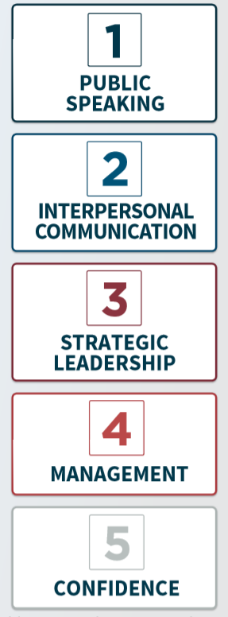
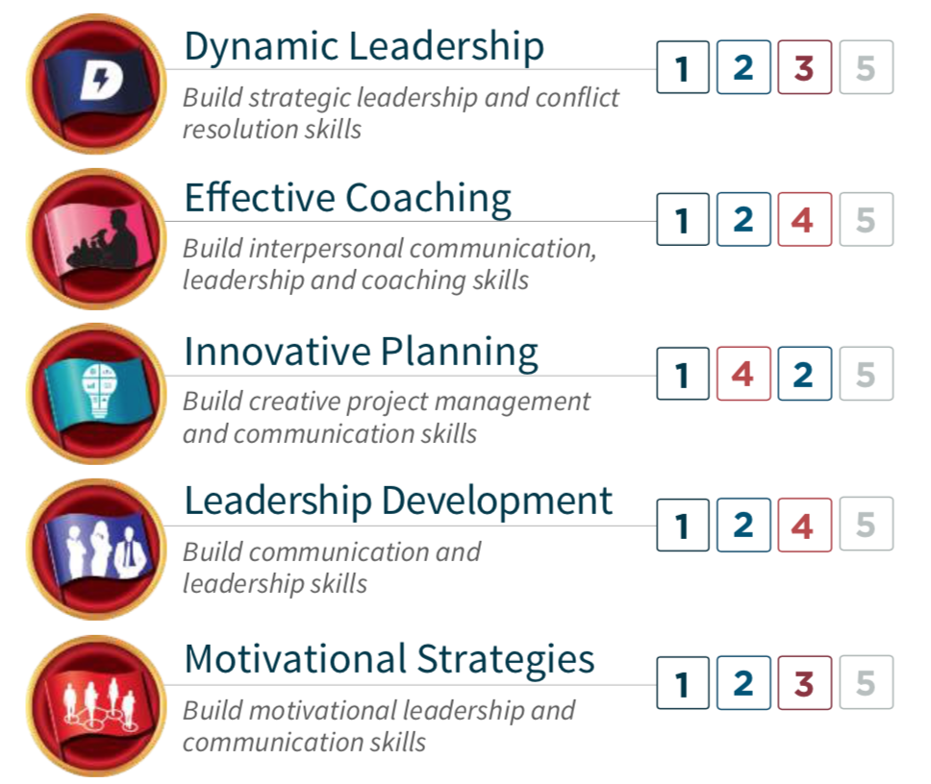
5 core competencies linked to 10 paths
Notes:
5 Kernkompetenzen:
Öffentliches Reden
Zwischenmenschliche Kommunikation
Strategische Führung
Management
Selbstvertrauen

Slide 7
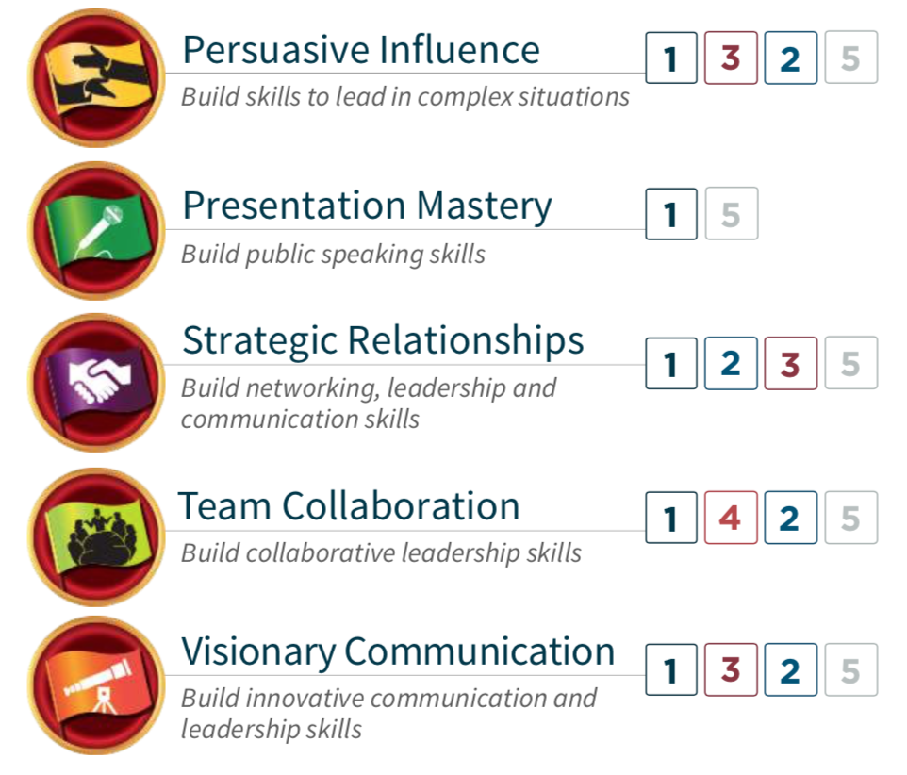
5 core competencies linked to 10 paths

Slide 8
5 Skill levels in each Path
Mastering fundamentals
Learning your style
Building skills
Demonstrating expertise
Increasing knowledge
Notes:
Meaning of 1 + 2, etc.: 1 compulsory project + 2 elective projects
5 Schwierigkeitsstufen
Grundlagen beherrschen
Eigenen Stil erkennen
Wissen aufbauen / erweitern
Fähigkeiten aufbauen / erweitern
Fachwissen demonstrieren

Slide 9
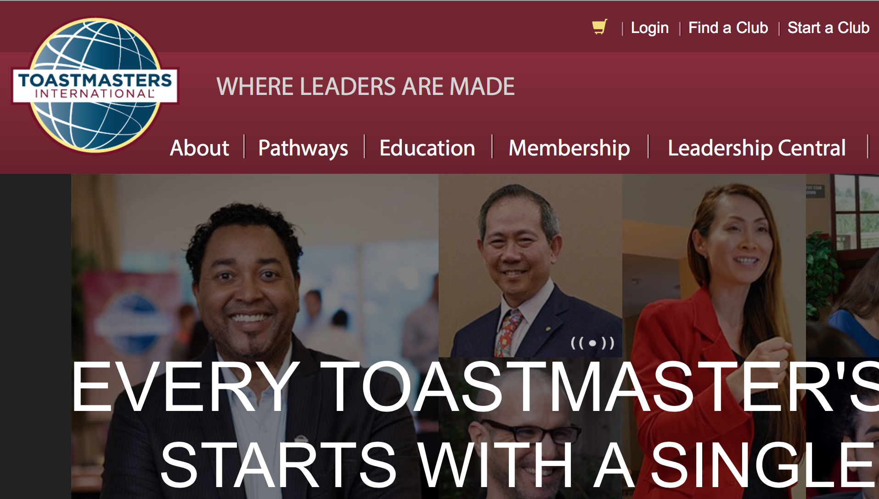
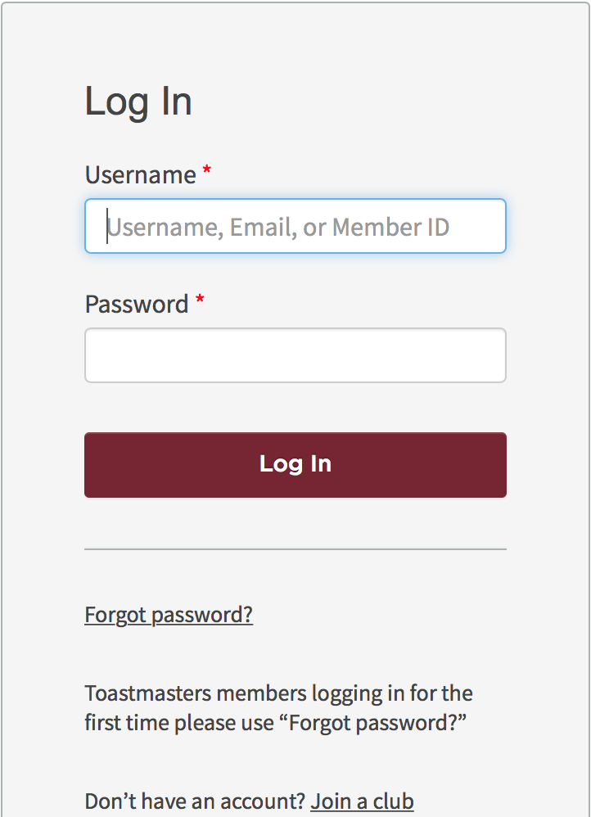
How do I access Pathways?
Notes:
www.toastmasters.org

Slide 10
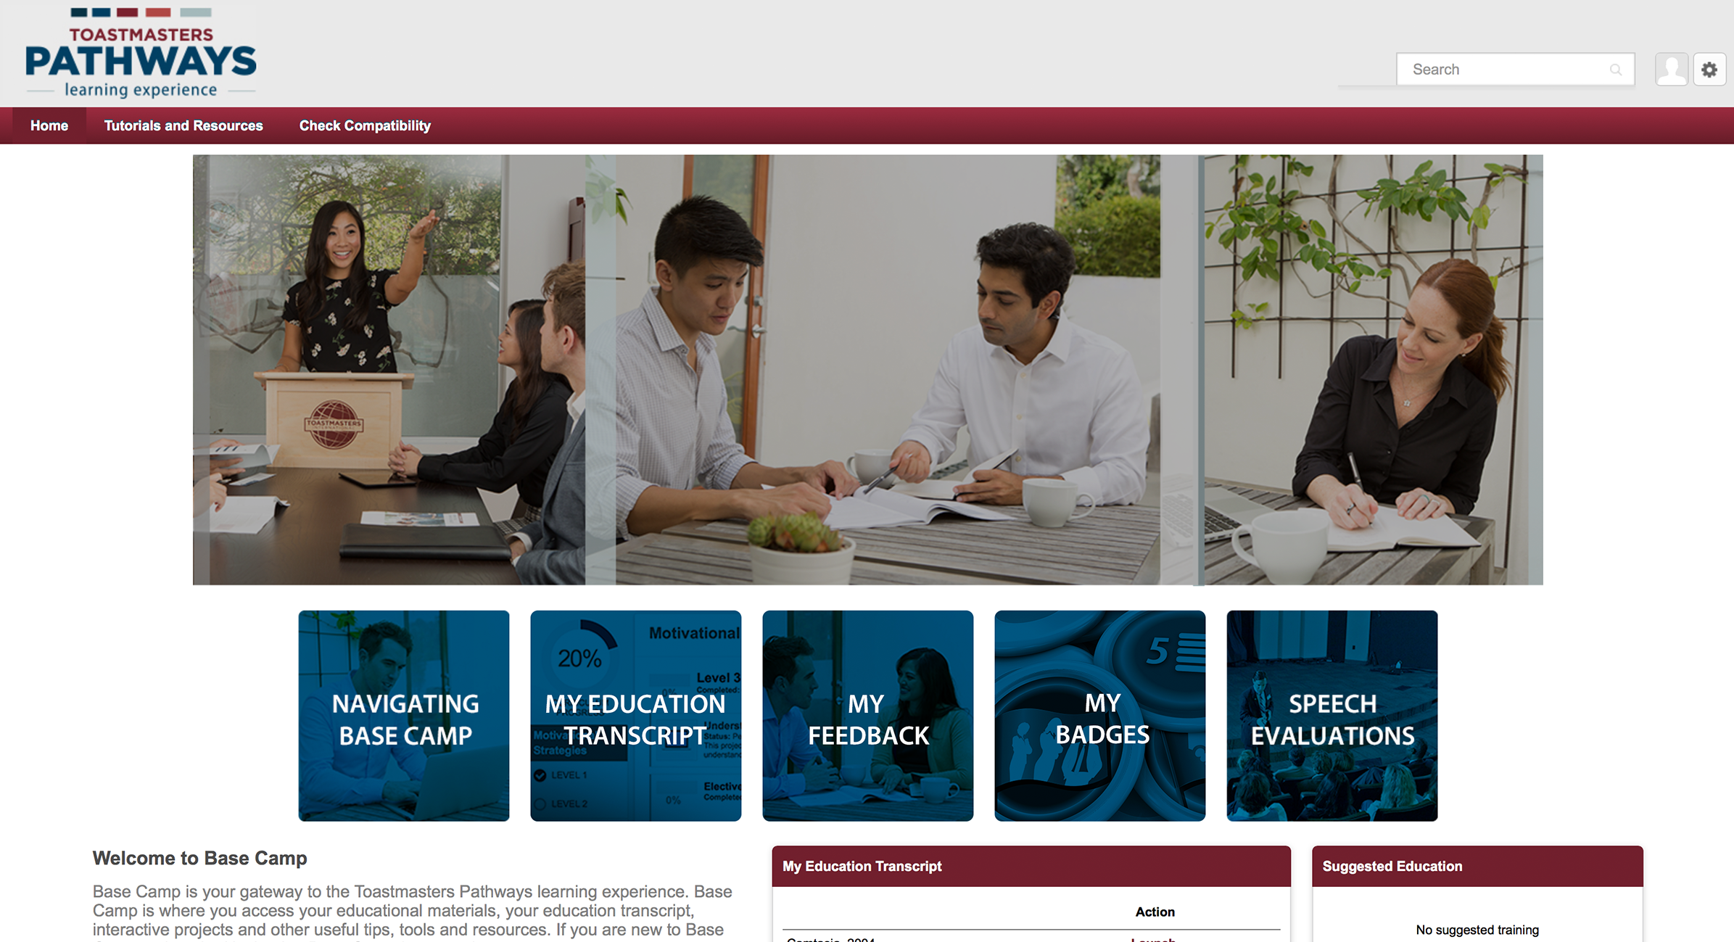
Compatibility check (1st time)
Remove
pop-up blockers
for https://toastmasters. csod.com
Notes:
Technische Voraussetzungen erfüllt?
Pop-up-Blocker für Toastmasters-Webseite entfernen

Slide 11
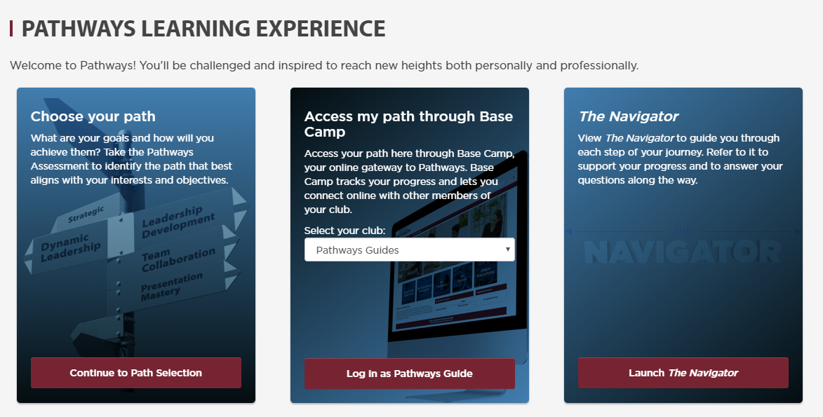
How do I get started?
Path selection
Access Base Camp
Navigator
Notes:
Navigator = short description / explanation of the Pathways program, meeting roles, club officers, etc.
→ Wegweiser / Wanderführer durch Pathways

Slide 12
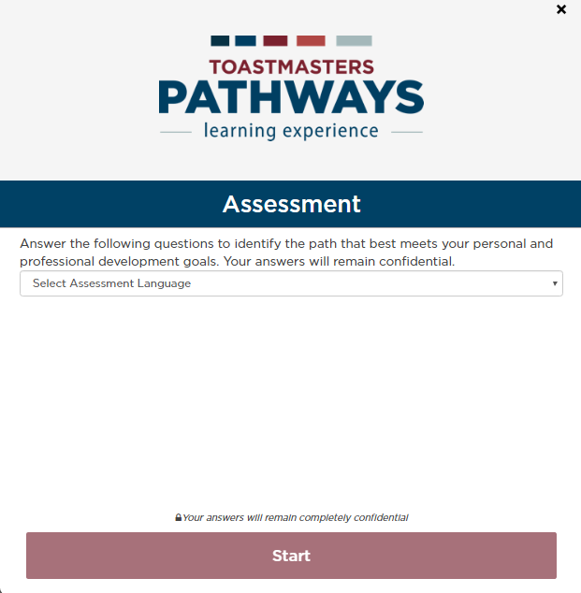
Initial self-assessment – choose your language

Slide 13
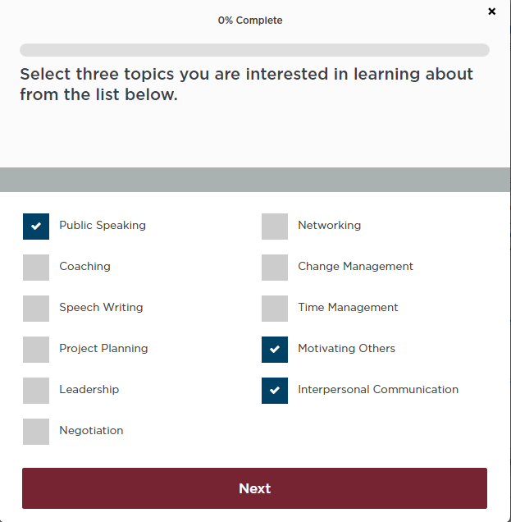
Initial self-assessment – what do you want to learn?

Slide 14
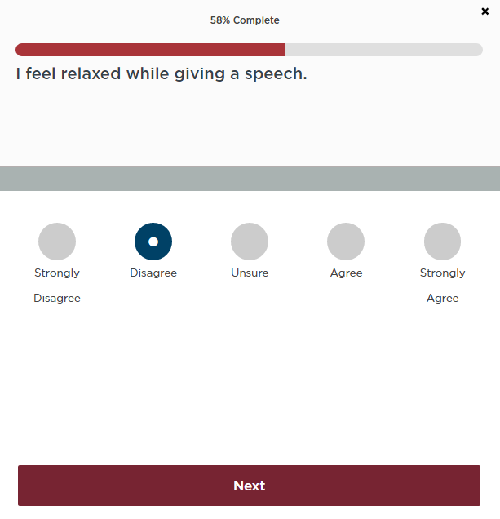
Initial self-assessment – what am I good at?

Slide 15
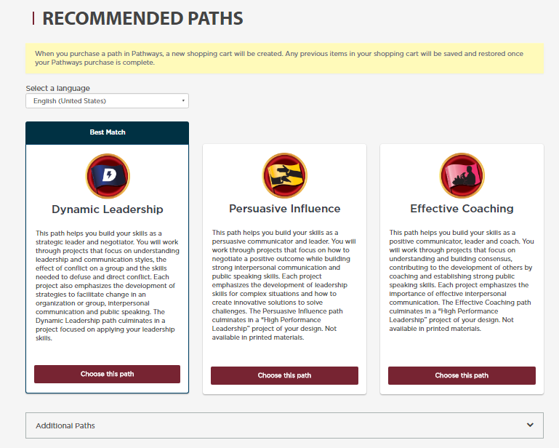
After self-assessment – 3 recommended paths

Slide 16
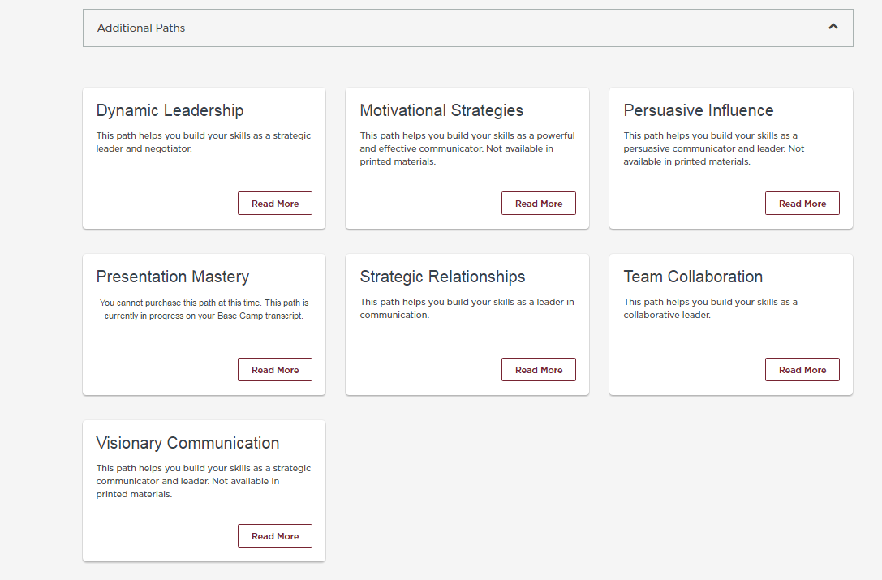
After self-assessment – you may still choose another path

Slide 17
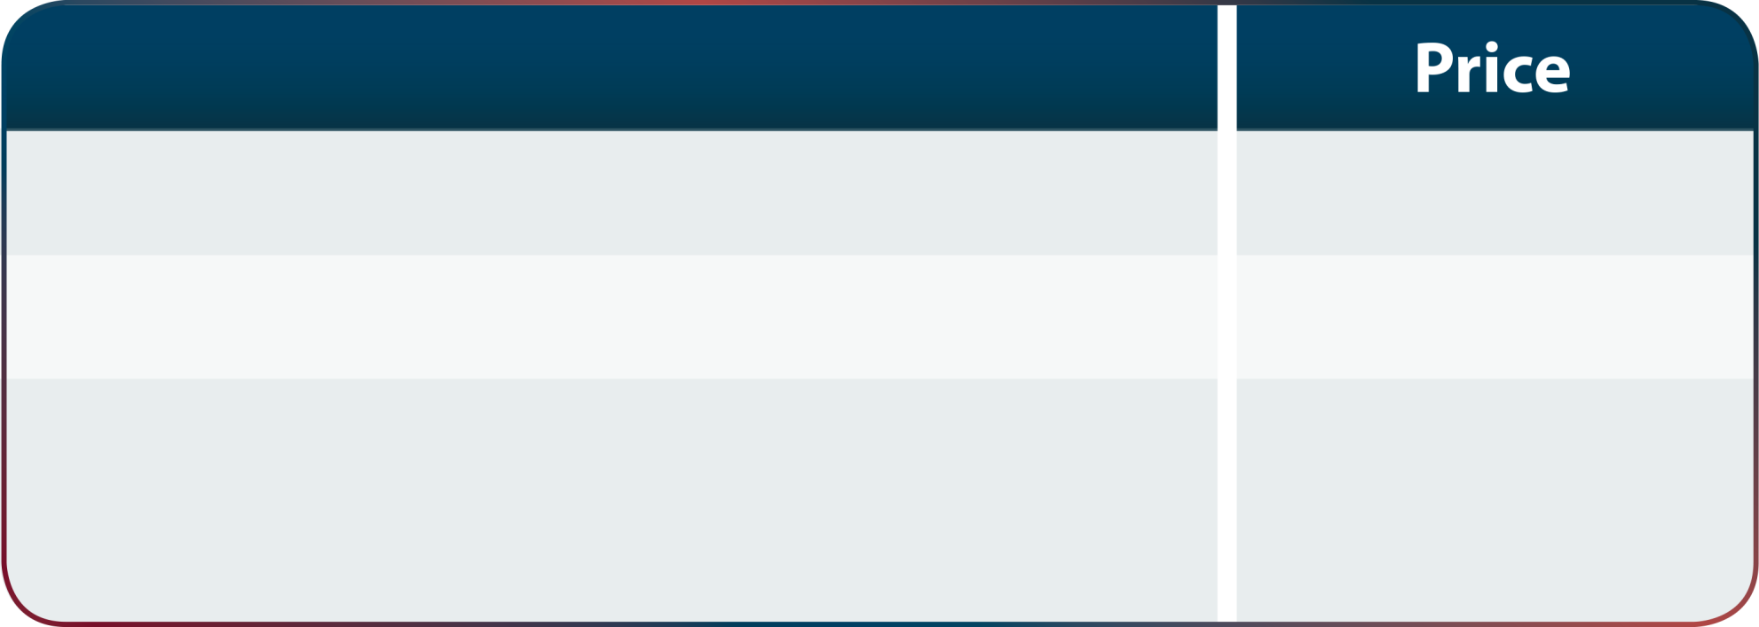
How much does it cost?
First path
Free
Second path and above
$20 USD
Additional fee for printed materials (including on first path)
$25 USD

Slide 18
First steps – first project: Ice Breaker

Slide 19
Basecamp – your entry point
Notes:
Technische Voraussetzungen erfüllt?
Pop-up-Blocker für Toastmasters-Webseite entfernen

Slide 20
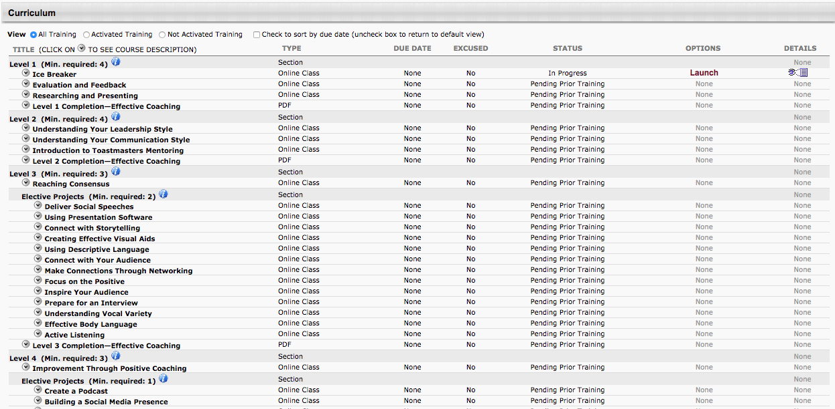
Basecamp for your preparation
Notes:
Technische Voraussetzungen erfüllt?
Pop-up-Blocker für Toastmasters-Webseite entfernen

Slide 21
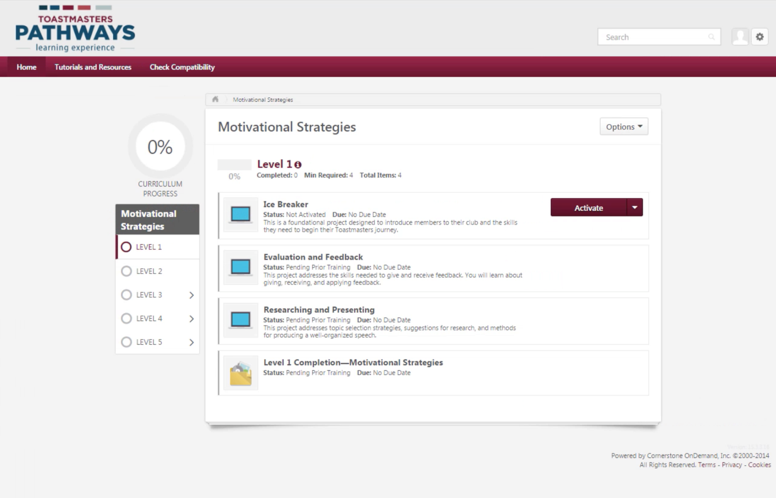
Tracking your Progress

Slide 22
Recognition and Badge after each level
Mastering fundamentals
Learning your style
Building skills
Demonstrating expertise
Increasing knowledge
Notes:
Meaning of 1 + 2, etc.: 1 compulsory project + 2 elective projects
5 Schwierigkeitsstufen
Grundlagen beherrschen
Eigenen Stil erkennen
Wissen aufbauen / erweitern
Fähigkeiten aufbauen / erweitern
Fachwissen demonstrieren

Slide 23
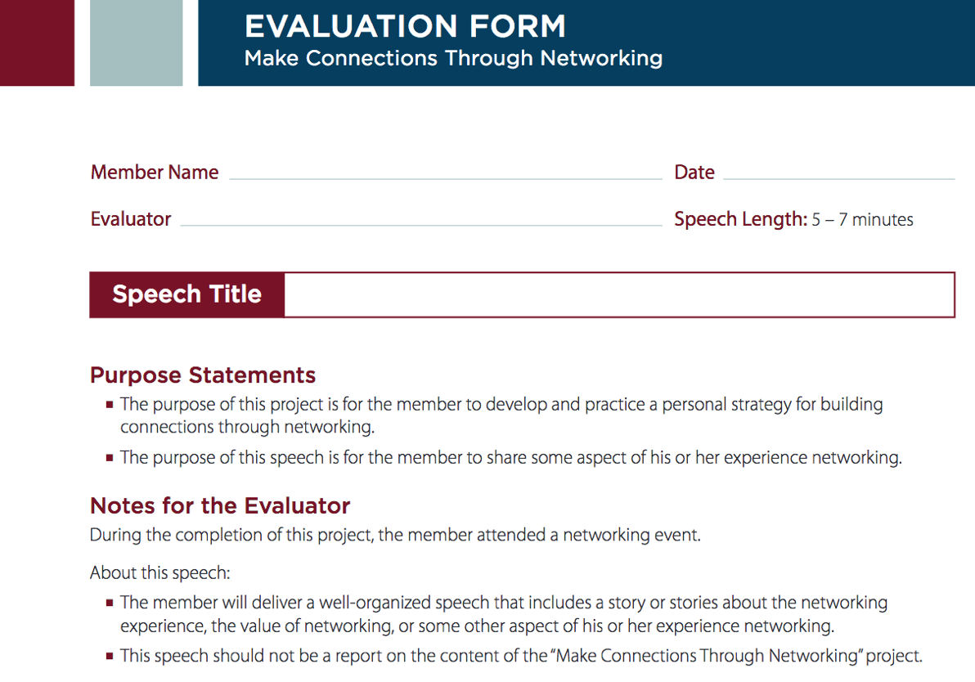
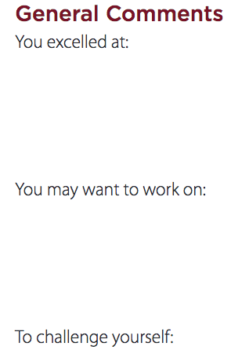
Evaluations
Notes:
General comments
Strengths
Suggestions
Scores
5 – 1
Specific evaluation criteria
Example: project Active Listening:
Vocal Variety:
Perfect use of tone, speed, and volume
Excels at using tone, speed, and volume as tools
....
Ineffective use of tone, speed, and volume

Slide 24
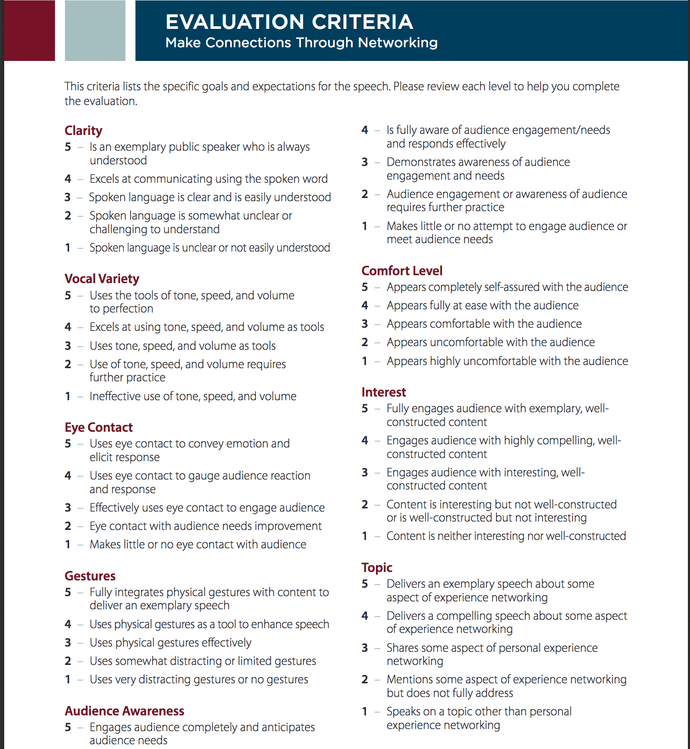
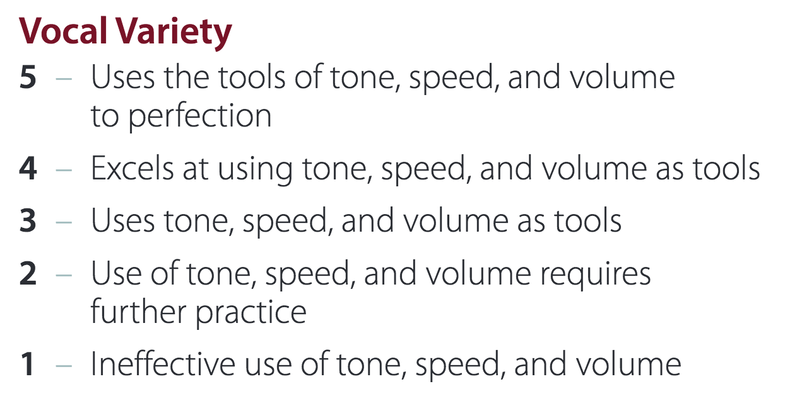
Notes:
Project: Make connections through networking

Slide 25
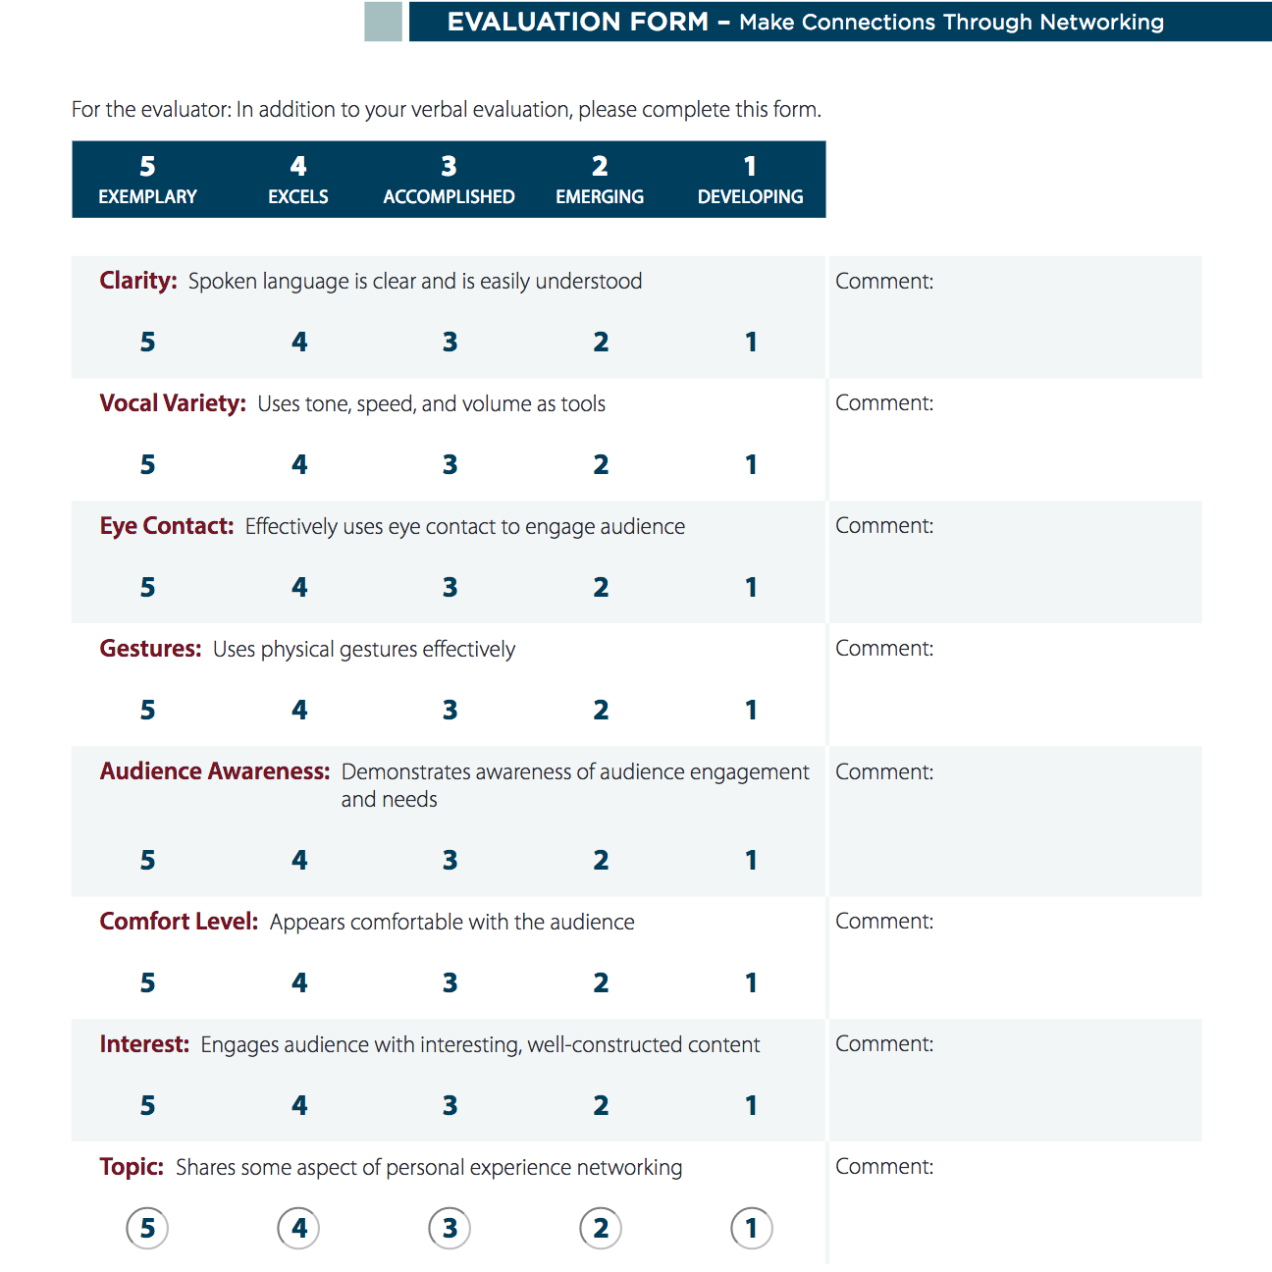
Notes:
Project: Make connections through networking

Slide 26
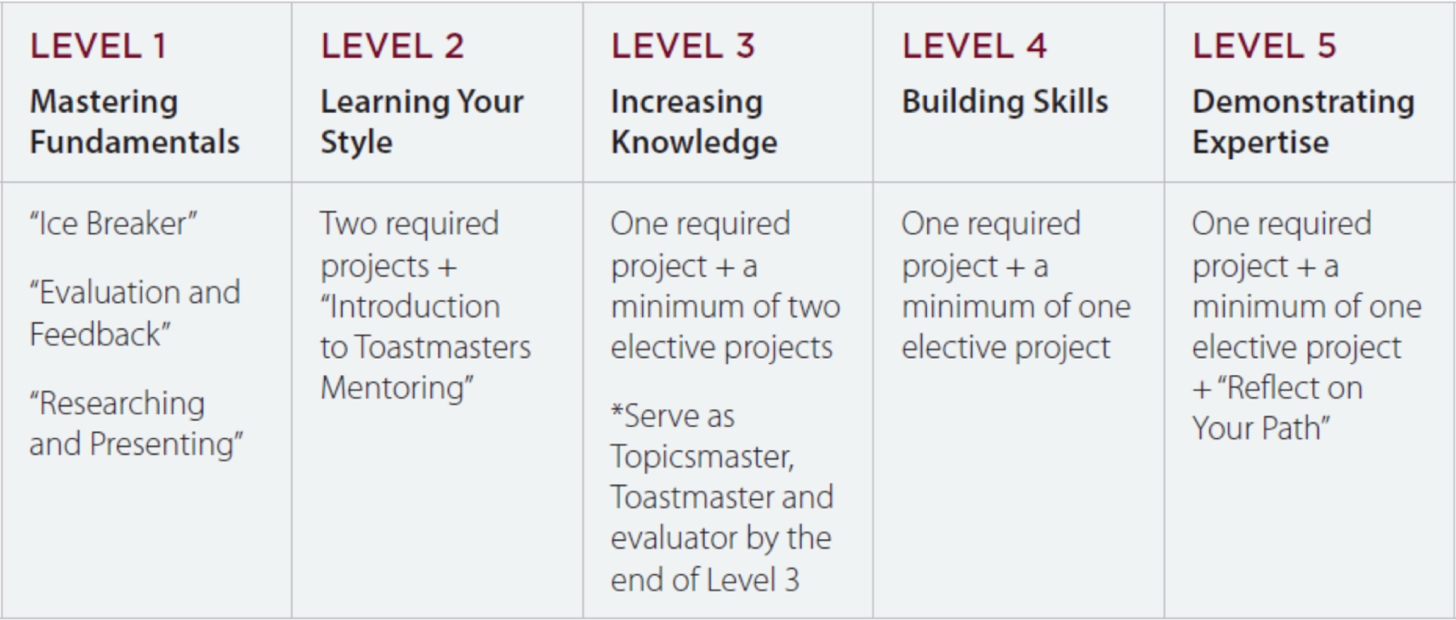
Levels and project types

Slide 27
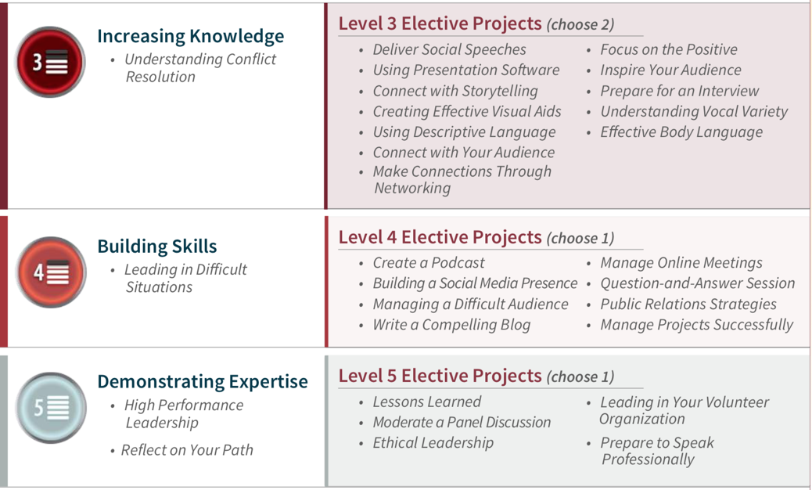
Example: Persuasive Influence
Notes:
Einflussreiche Ueberzeugungskraft

Slide 28
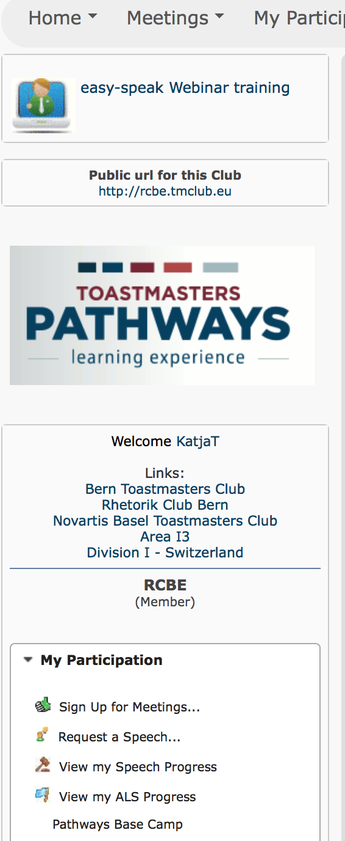
Pathways and Easy-Speak
For your projects, preparation, progress and achievements
For preparation of meeting agenda and to request a speech
Notes:
The Way of St. James / Road to Santiago / Camino de Santiago
Jakobsweg
- Meeting management vs tracking + learning + resources in Pathways / Base Camp
- Meetings stay the same, it’s up to the club to which degree you integrate digital tools into the meetings, e.g. by filling in the evaluation forms on an iPad etc.

Slide 29
Technical requirements
Minimum requirements for faster download speeds:
Computer: 1 GB of RAM, 1 GHz Processor
Display resolution: 1024 x 768
Network and connectivity: 5Mbit/s (recommended: 8Mbits/s)
Browser with TLS 1.1 or higher enabled
Pop-up blocker disabled
JavaScript enabled
Useable browsers:
Microsoft Edge
Internet Explorer Version 10.0 or higher
Chrome 22.0 or higher
Safari Version 7.0 or higher
Mozilla Firefox Version 23.0 or higher
Opera Version 11 or higher
Note: If your system does not meet the minimum requirements, you may experience longer download times.
https://www.toastmasters.org/Education/Pathways/FAQ#faqTop

Slide 30
What do you need for a DTM?
Notes:
Navigator = short description / explanation of the Pathways program, meeting roles, club officers, etc.
→ Wegweiser / Wanderführer durch Pathways

Slide 31
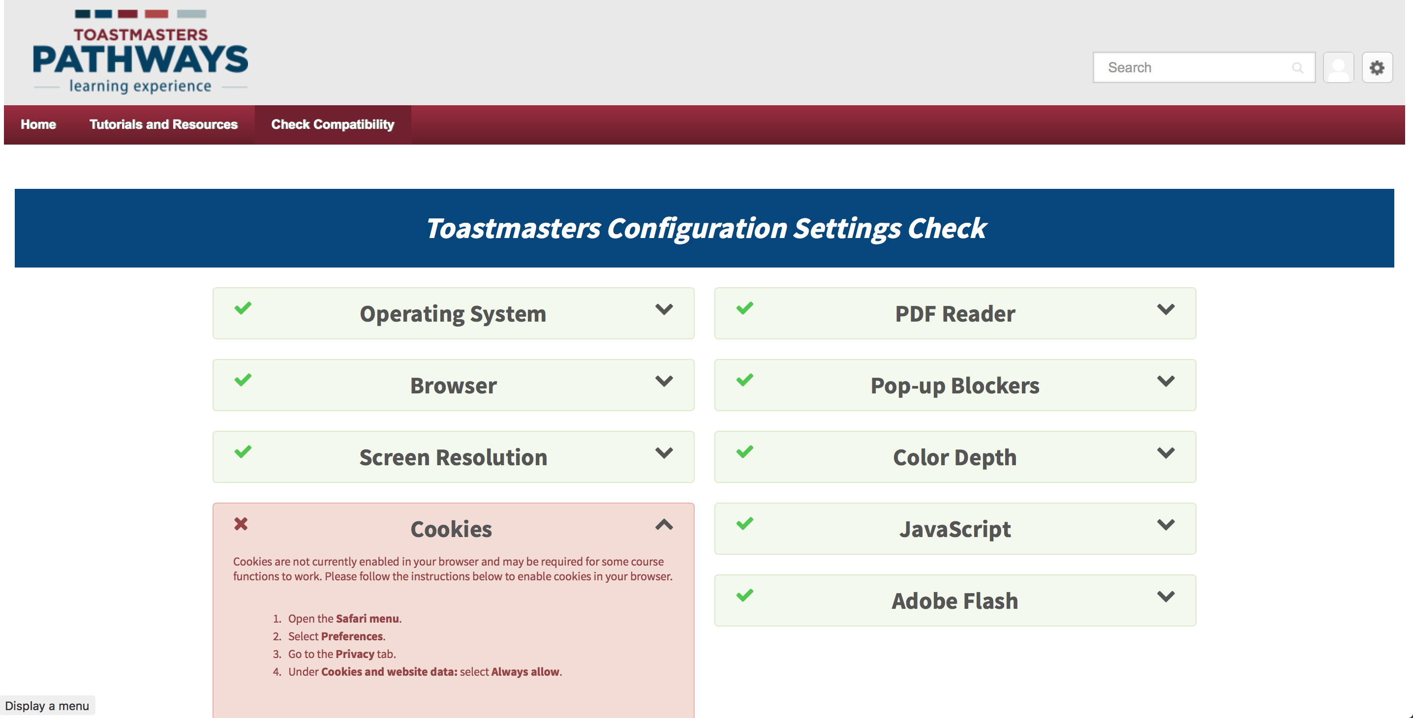
Compatibility check – how does it look like?
Notes:
This is an example of my Safari browser; it wasn’t possible to get the “the green light” for the “Cookies”. However, it should nonetheless work.
If it doesn’t and you are sure it’s not related to company restrictions, you might rather try it with one of the other 5 browsers. With Firefox, I had no issue to get all the settings as requested.

Slide 32
Why disable pop-up blockers?
It is common configuration for learning management systems and other websites to open additional content in new windows. Often, these new windows are recognized as pop-ups by your web browser. Because projects, tutorials, and resources on Base Camp all open in new windows, your pop-up blockers must be turned off so your browser does not prevent you from accessing them.
Instructions how to disable pop-up blockers, click on the corresponding link:
Mozilla: https://support.mozilla.org/en-US/kb/pop-blocker-settings-exceptions-troubleshooting
Chrome: https://support.google.com/chrome/answer/95472
Internet Explorer 11: https://support.microsoft.com/en-us/help/17479/windows-internet-explorer-11-change-security-privacy-settings
Microsoft Edge: https://support.microsoft.com/en-us/help/4026392/windows-block-pop-ups-in-microsoft-edge
Apple Safari: https://support.apple.com/en-gb/guide/safari/block-pop-ups-and-unnecessary-content-sfri40696
From Pathways Master Q & A

Slide 33
Technical matters
Operating systems:
Ok: Windows + Mac
Not ok: Linux
Browsers:
Safari seems not to be fully operational
Alternatives: Firefox, Chrome, etc.
TMI: « If members already have a Flash player on their computer or device, they do not need to worry about the Java notice on the Configuration Checker page. Base Camp should work with the version they already have. »

Slide 34
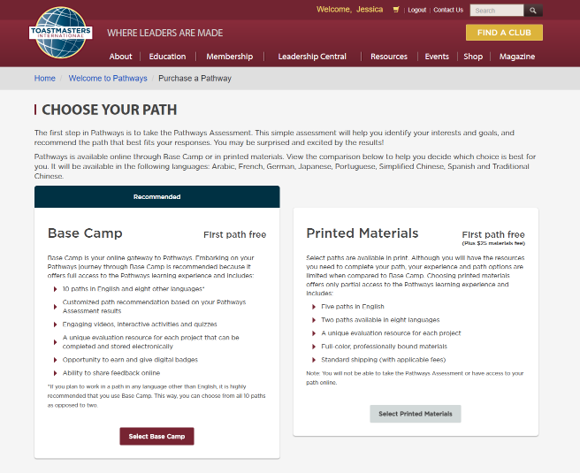
Online or print?

Slide 35
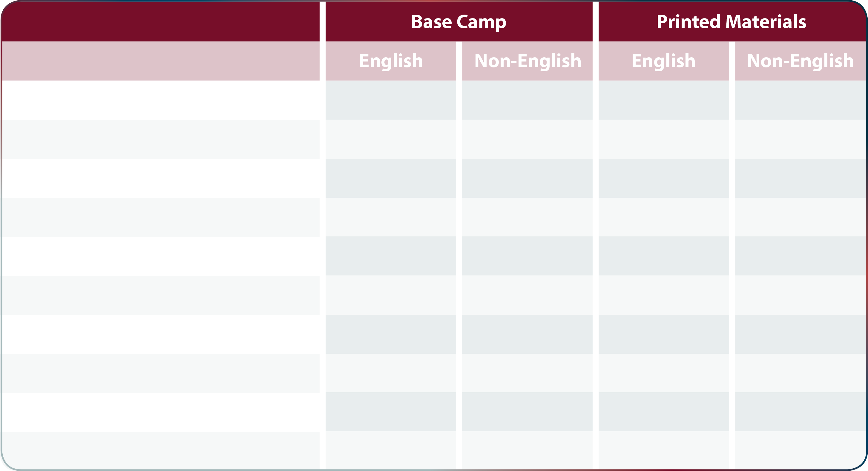
Online or print?
Dynamic Leadership
✔
✔
✔
Effective Coaching
✔
✔
Innovative Planning
✔
✔
Leadership Development
✔
✔
✔
✔
Motivation Strategies
✔
✔
Persuasive Influence
✔
✔
Presentation Mastery
✔
✔
✔
✔
Strategic Relationships
✔
✔
✔
Team Collaboration
✔
✔
✔
Visionary Communication
✔
✔

Slide 36
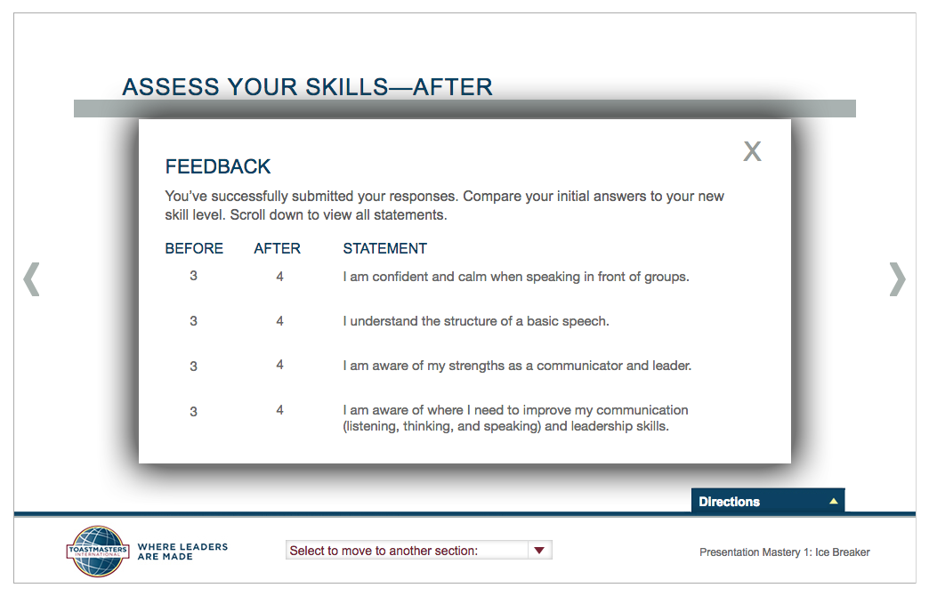
Self-assessment before and after project: Any progress in my skills?

Slide 37
Distinguished Club Program (DCP)
During transition till May 2020
More options to meet goals

Slide 38
Navigator – Toastmasters explained

Slide 39
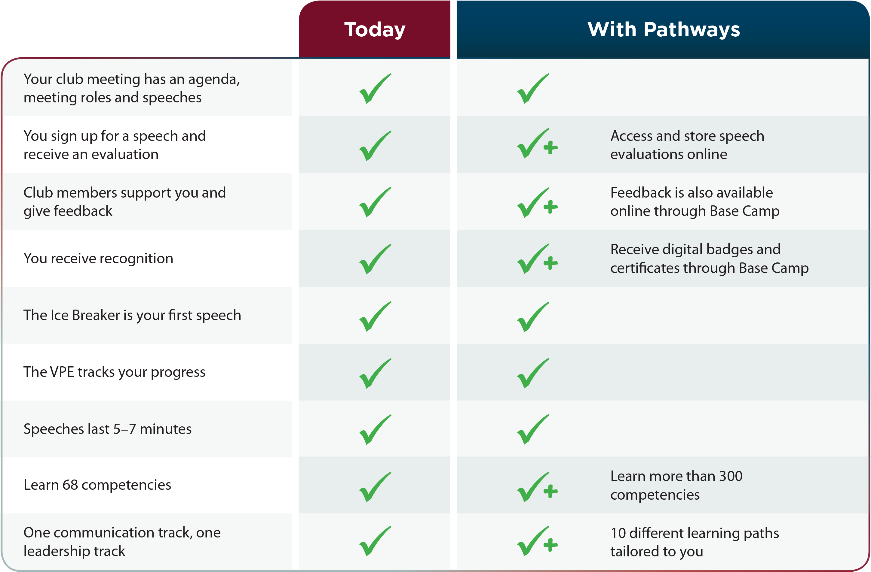
Meetings today vs. with Pathways

Slide 40
Advantages of Pathways
High value
Fun
Customized to your needs
Flexible
Competency-based
Resource-rich
Meaningful, effective evaluations

Slide 41
Advantages of Pathways
Tailored, self-paced learning
Flexibility to choose path and elective projects
Greater access to materials
Expanded resources
Real-world applicability

Slide 42
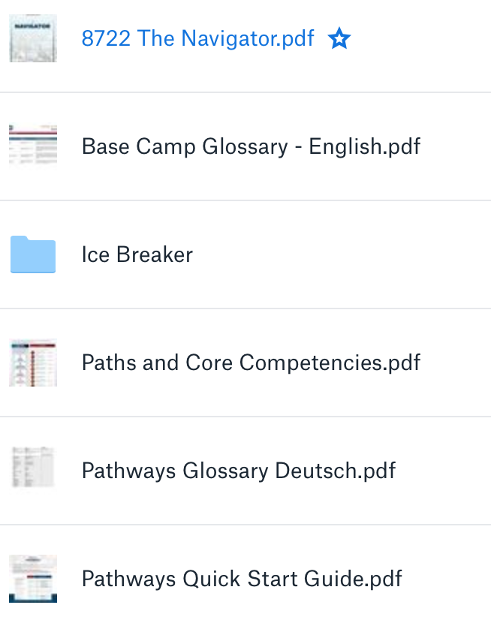
Useful links
Pathways Overview: https://www.toastmasters.org/pathways-overview
Ice Breaker: https://www.toastmasters.org/websiteApps/Pathways/IceBreaker/tm100101/index.html
Pathways FAQ: https://www.toastmasters.org/Education/Pathways/FAQ
Dropbox with further documents, e.g. path descriptions:
Q&A: https://www.dropbox.com/s/vaebxtigsk6wjhp/A%20-%20Pathways%20-%20Q%20%26%20A_Katja.docx?dl=0
https://www.dropbox.com/sh/dtrmid1hgrp44xh/AABItZOehckf-E2eIexzuuGTa?dl=0

Slide 43
Sources
https://www.youtube.com/watch?v=ewU_BbArY88
https://i.pinimg.com/564x/bf/25/52/bf2552d06de8610f40ad954c41b97cfa--machine-a-olympia.jpg
https://www.toastmasters.org/resources/the-toastmasters-educational-program
Pathways Learning Experience Presentation (2 variants)
https://www.bildungsreise.org/wp-content/uploads/2016/10/bildungsreise-pilgerreise-jakobsweg.jpg
https://encrypted-tbn0.gstatic.com/images?q=tbn:ANd9GcQG12qH9cqVl5EJqk2xFMsJ_QW4JUDQPuGDZYMawaUiB08gaiTVFQ

